Slide 1
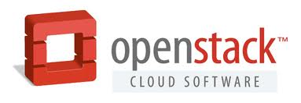

OpenStack l2 network topology
Tech. Competition
@ DUCN.SH
Notes:
2013-08-06
VM snapshot for Enhanced Troubleshooting in Cloud

Slide 2
background
OpenStack
  OpenStack is a open source cloud computing platform for public and private clouds. It aims to deliver solutions for all types of clouds by being simple to implement, massively scalable, and feature rich. The technology consists of a series of interrelated projects delivering various components for a cloud infrastructure solution.
  http://www.openstack.org/
OpenVSwitch
  Open vSwitch is a production quality, multilayer virtual switch which is designed to enable massive network automation through programmatic extension, while still supporting standard management interfaces and protocols (e.g. NetFlow, sFlow, SPAN, RSPAN, CLI, LACP, 802.1ag). In addition, it is designed to support distribution across multiple physical servers similar to VMware's vNetwork distributed vswitch or Cisco's Nexus 1000V.
  http://openvswitch.org/
Both OpenStack and OpenVSwitch are key components of Ericsson Cloud System.
By network virtualization technologies provided by OpenStack and OpenVSwitch, the network topology (both L2 and L3) are becoming much more complicated. Therefore, the trouble-shooting on networking problems are much more effort-consumed than before.
Notes:
These problems are mainly impossible to reproduce in our Ericsson Lab environment because network topology and deployment scenarios are usually different than the lab environment setup, especially when integration / interworking with other networks they own
Even the setup is similar, some of the problems are still very hard to reproduce because the traffic scenarios on customer live network are very different from the official design and very hard to predict in product development phase.
Lacking of troubleshooting mechanisms:
- Log level usually doesn’t detail enough to figure out the problem
- Tracing usually doesn’t turned on due to heavy performance impacts
- Memory dump takes CPU power and may impact traffic fallback latency, meanwhile it only provides static data for analysis
2013-08-06
VM snapshot for Enhanced Troubleshooting in Cloud

Slide 3
Background – cont.
OpenStack provides L3 network topology already (See example figure in next slide).
We believe L2 network topology is also needed and will facilitate the network trouble-shooting a lot.
One vaxthus idea existed already.
  https://ericoll.internal.ericsson.com/sites/IdeaBoxes/Ideas/display.aspx?ID=Pgz+zn/eTtI=&title=M4sc8MGguNgQmlKkvVGVA4EpbnTbICYIudxzL+DSnzyE7eWrdjD73BUDAPCXUgOALHN/MnZJMJNxAapyCT5C/qnzO1ahLp2i&src=http%3a%2f%2fericoll.internal.ericsson.com%3a80%2fsites%2fIdeaBoxes%2fMyIdeas.aspx

Slide 4
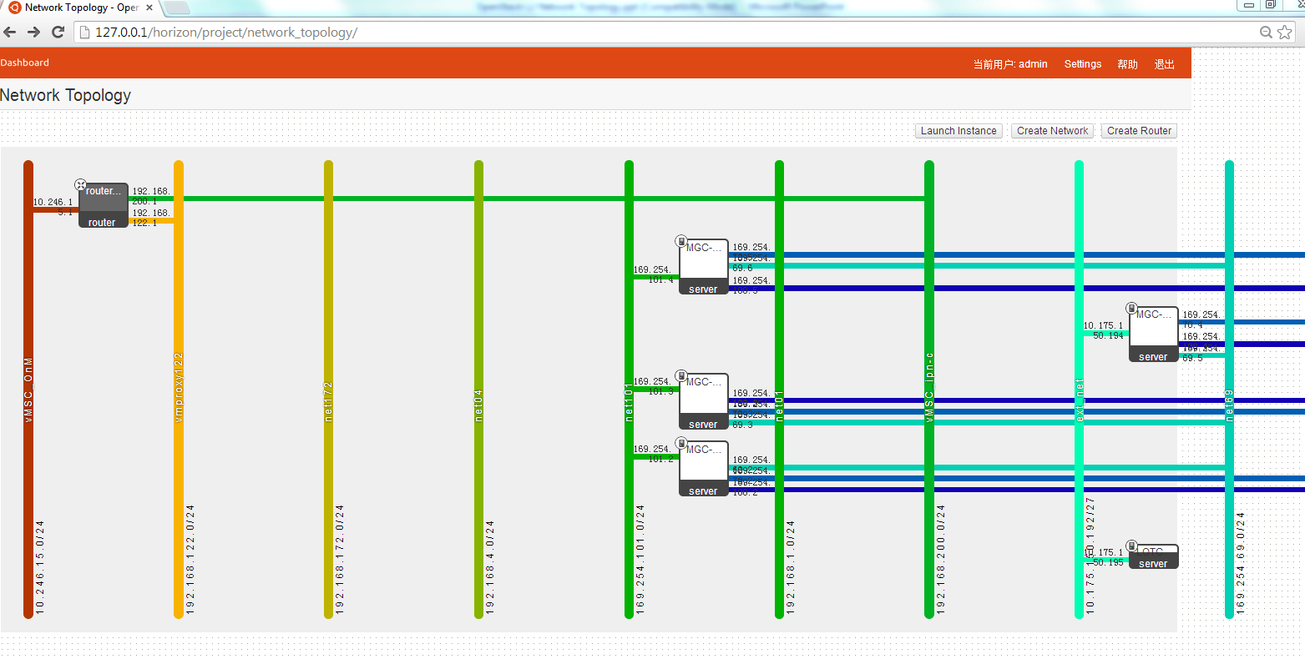
L3 network topology example

Slide 5
Openstack Demo setup
SSH to below ITTE RSG
  IP:10.175.245.2
  Username:rdcchhb, password:Rdcchhb_123
SSH to OpenStack Server
  IP:10.175.150.3
  Username:localadmin, password:3r1cs50n (talk with James to set a new account).
Setup SSH tunnel on port 80 and 6080 via ITTE RSG. Access Horizon (OpenStack Dashboard) as below:
  http://127.0.0.1/horizon (use chrome or firefox)
  Username:admin, password:admin
  Please do not change the password and configurations of the demo setup.

Slide 6
How to Retrieve L2 network info
Commands or APIs
  OpenVSwitch Info
    ovs-vsctl show
  Linux Bridge Info (optional)
    brctl show
  NIC Device Info
    ifconfig
  OpenStack Network/Subnet/Port Info
    quantum net-list; quantum subnet-list; quantum port-list;
  OpenStack VM Info
    nova list

Slide 7
objectives
We want to get a L2 network topology including below information:
  L2 devices, including physical nics, bridges, tap/vnet devices, VMs.
  L2 network connection between all above-mentioned devices.
  See next slide for an example.

Slide 8
L2 setup example
Openstack(grizzly) setup @ demo lab
Interface Legend
Host: 10.175.150.5
Host: 10.175.150.3
Untagged
VM1
VM2
VM3
VM4
Tagged
eth0
eth0
eth1
eth0
eth0
tapxxxx
tapyyyy
tapzzzz
tapuuuu
tapvvvv
qbrxxxx
ETHA/B
ETHA/B
Device Legend
qbryyyy
qbrzzzz
qbruuuu
qbrvvvv
qvbxxxx
qvbyyyy
qvbzzzz
qvbuuuu
qvbvvvv
TAP Device
ETH Device
qvoxxxx
qvoyyyy
qvozzzz
qvouuuu
qvovvvv
VETH Pair
tap-cp-a
tap-cp-a
br-int
br-int
Linux Bridge
Int-br-ex
Int-br-eth2
Int-br-eth2
Int-br-ex
OVS Bridge
phy-br-ex
phy-br-eth2
phy-br-eth2
phy-br-ex
br-ex
br-eth2
br-eth2
br-ex
eth3
eth2
eth2
eth3
external
internal
external
L2 Network

Slide 9

Notes:
2013-08-06
VM snapshot for Enhanced Troubleshooting in Cloud

